Slide 1
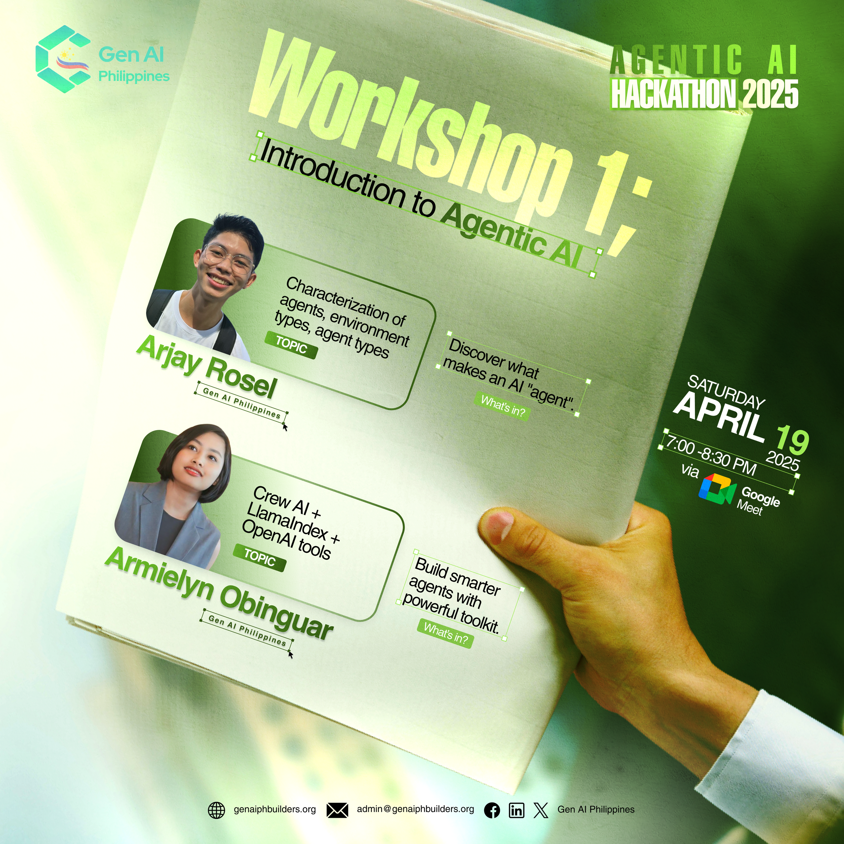

We will begin shortly.

Slide 2



Slide 4
ICEBREAKER:
Kung AI agent ka, anong klaseng agent ka today?

Slide 5




















PARTNERS

Slide 6



GOLD SPONSOR
Apper
Cloud Labs

Slide 7

GOLD SPONSOR
Tars AI

Slide 8



SILVER SPONSOR

Slide 11
Outline
Agents and environments
Rationality
PEAS (Performance measure, Environment, Actuators, Sensors)
Environment types
Agent types
Reference: Artificial Intelligence: A modern approach

Slide 12
The PEAS Model
Reference: Artificial Intelligence: A modern approach

Slide 13
Agents
An agent is anything that can be viewed as perceiving its environment through sensors and acting upon that environment through actuators
Human agent:
–eyes, ears, and other organs for sensors;
–hands, legs, mouth, and other body parts for actuators
Robotic agent:
–cameras and infrared range finders for sensors
–various motors for actuators
Reference: Artificial Intelligence: A modern approach

Slide 14
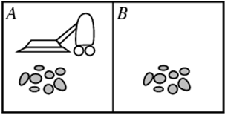
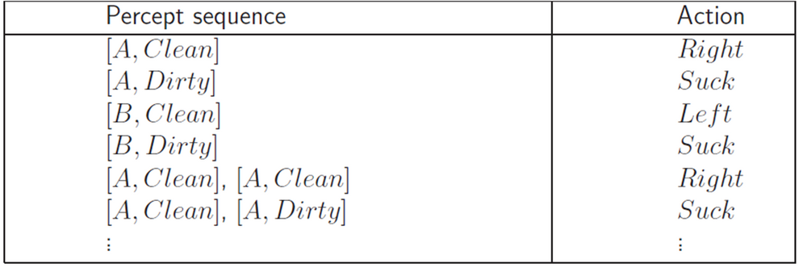
Vacuum-cleaner world
Percepts: location and contents, e.g., [A,Dirty]
Actions: Left, Right, Suck, NoOp
Agent’s function -> look-up table
For many agents this is a very large table
Reference: Artificial Intelligence: A modern approach

Slide 15
Rational agents
Rationality
– Performance measuring success
– Agents prior knowledge of environment
– Actions that agent can perform
– Agent’s percept sequence to date
Rational Agent: For each possible percept sequence, a rational agent should select an action that is expected to maximize its performance measure, given the evidence provided by the percept sequence and whatever built-in knowledge the agent has.
Reference: Artificial Intelligence: A modern approach

Slide 16
CHECKPOINT!
A rational agent
finds a correct solution every time.
achieves optimal performance every time.
achieves the best performance on average.
achieves the best worst-case performance.
Pick one.

Reference: Artificial Intelligence: A modern approach

Slide 17
Rationality
Rational vs omniscience
Rational vs being perfect
Reference: Artificial Intelligence: A modern approach

Slide 18
Autonomy in Agents
The autonomy of an agent is the extent to which its
behaviour is determined by its own experience,
rather than knowledge of designer.
Extremes
No autonomy – ignores environment/data
Complete autonomy – must act randomly/no program
Example: baby learning to crawl
Ideal: design agents to have some autonomy
Possibly become more autonomous with experience
Reference: Artificial Intelligence: A modern approach

Slide 19
CHECKPOINT!
PEAS stands for
Green vegetables.
Peace, Environment, Action, Service
Performance, Environment, Agent, Search.
Performance, Environment, Actuators, Sensors.
Pick one.

Reference: Artificial Intelligence: A modern approach

Slide 20
PEAS
PEAS: Performance measure, Environment, Actuators, Sensors.
Must first specify the setting for intelligent agent design
Consider, e.g., the task of designing an automated taxi driver:
– Performance measure: Safe, fast, legal, comfortable trip, maximize profits
– Environment: Roads, other traffic, pedestrians, customers.
– Actuators: Steering wheel, accelerator, brake, signal, horn.
– Sensors: Cameras, sonar, speedometer, GPS, odometer, engine sensors, keyboard
Reference: Artificial Intelligence: A modern approach

Slide 21
PEAS
Agent: Part-picking robot
Performance measure: Percentage of parts in correct bins
Environment: Conveyor belt with parts, bins
Actuators: Jointed arm and hand
Sensors: Camera, joint angle sensors
Reference: Artificial Intelligence: A modern approach

Slide 22
PEAS
Agent: Interactive English tutor
Performance measure: Maximize student's score on test
Environment: Set of students
Actuators: Screen display (exercises, suggestions, corrections)
Sensors: Keyboard
Reference: Artificial Intelligence: A modern approach

Slide 23
Environments
Reference: Artificial Intelligence: A modern approach

Slide 24
CHECKPOINT!
In an episodic environment
outcomes do not depend on action history.
outcomes do depend on action history.
The environment does not change while the agent is planning.
Other agents are involved in the episode.
Check one.

Reference: Artificial Intelligence: A modern approach

Slide 25
Environment Types
Fully observable (vs. partially observable)
Deterministic (vs. stochastic)
Episodic (vs. sequential)
Static (vs. dynamic)
Discrete (vs. continuous)
Single agent (vs. multiagent)
Reference: Artificial Intelligence: A modern approach

Slide 26

Fully observable (vs. partially observable)
Is everything an agent requires to choose its actions available to it via its sensors?
If so, the environment is fully observable
If not, parts of the environment are unobservable.
Agent must make informed guesses about world.
Reference: Artificial Intelligence: A modern approach

Slide 27

Deterministic (vs. stochastic)
Does the change in world state depend only on current state and agent’s action?
Non-deterministic environments
Have aspects beyond the control of the agent
Utility functions have to guess at changes in world
Reference: Artificial Intelligence: A modern approach

Slide 28

Episodic (vs. sequential)
Is the choice of current action
Dependent on previous actions?
If not, then the environment is episodic
In sequential environments:
Agent has to plan ahead: Current choice will affect future actions

Reference: Artificial Intelligence: A modern approach

Slide 29

Static (vs. dynamic)
Static environments don’t change
While the agent is deliberating over what to do
Dynamic environments do change
So agent should/could consult the world when choosing actions
Semidynamic: If the environment itself does not change with the passage of time but the agent's performance score does.

Another example: off-line route planning vs. on-board navigation system
Reference: Artificial Intelligence: A modern approach

Slide 30
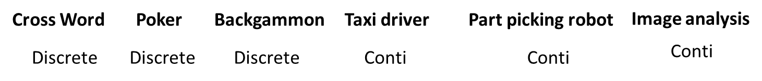
Discrete (vs. continuous)
A limited number of distinct, clearly defined percepts and actions vs. a range of values (continuous)
Reference: Artificial Intelligence: A modern approach

Slide 31
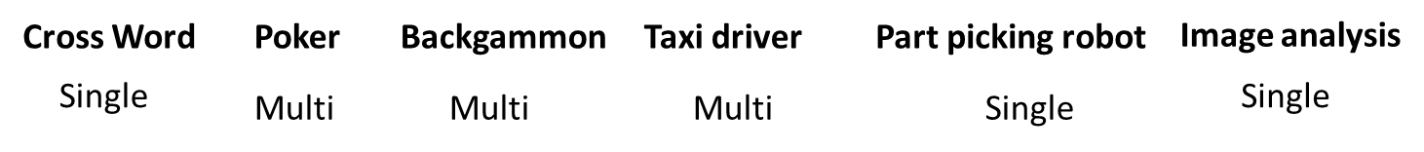
Single agent (vs. multiagent):
An agent operating by itself in an environment vs. there are many agents working together
Reference: Artificial Intelligence: A modern approach

Slide 32
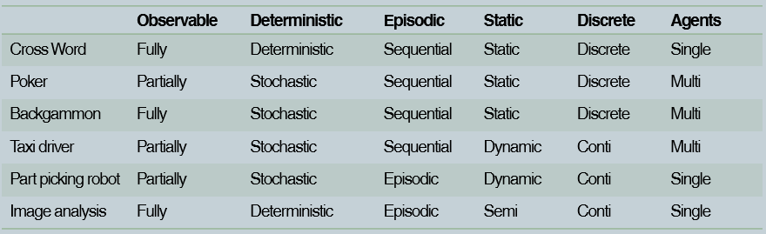
Summary
Reference: Artificial Intelligence: A modern approach

Slide 33
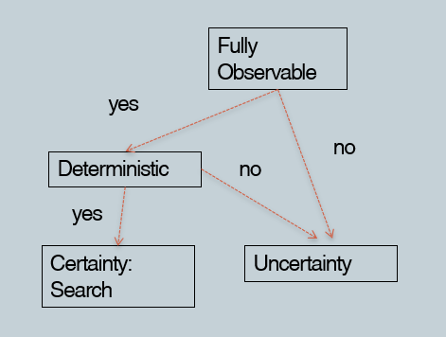
Environments and Rational Choice
Reference: Artificial Intelligence: A modern approach

Slide 34
Agents
Reference: Artificial Intelligence: A modern approach

Slide 35
CHECKPOINT!
A goal-based agent
uses reflexes to reach a goal.
maximizes average performance.
selects actions to reach a goal given sensory input.
learns from its experience.
Select one.
Reference: Artificial Intelligence: A modern approach

Slide 36
Agent types
Four basic types in order of increasing generality:
Simple reflex agents
Reflex agents with state/model
Goal-based agents
Utility-based agents
All these can be turned into learning agents
Reference: Artificial Intelligence: A modern approach

Slide 37
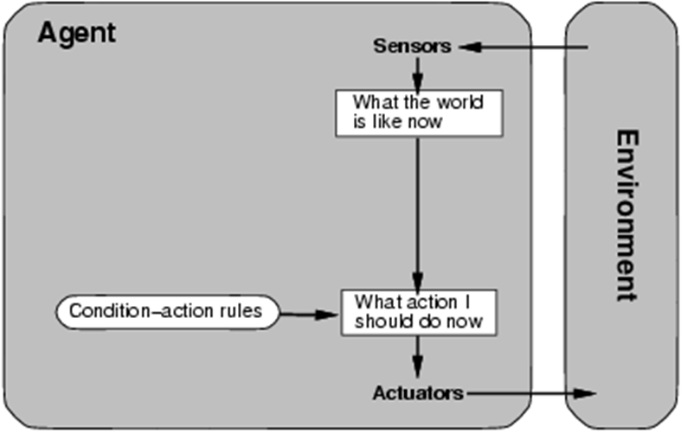
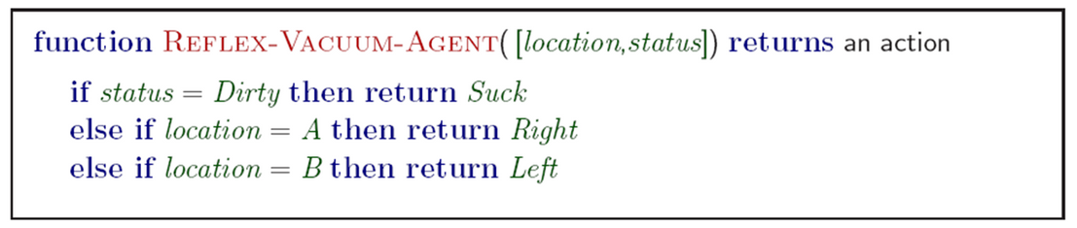
Simple reflex agents
Reference: Artificial Intelligence: A modern approach

Slide 38
Simple reflex agents
Simple but very limited intelligence.
Action does not depend on percept history, only on current percept.
Thermostat.
Therefore no memory requirements.
Infinite loops
Suppose vacuum cleaner does not observe location. What do you do given location = clean? Left on A or right on B -> infinite loop.
Fly buzzing around window or light
Possible Solution: Randomize action.
Reference: Artificial Intelligence: A modern approach

Slide 39
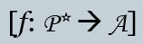

States: Beyond Reflexes
Recall the agent function that maps from percept histories to actions:
An agent program can implement an agent function by maintaining an internal state.
The internal state can contain information about the state of the external environment.
The state depends on the history of percepts and on the history of actions taken:
where S is the set of states.
Reference: Artificial Intelligence: A modern approach

Slide 40
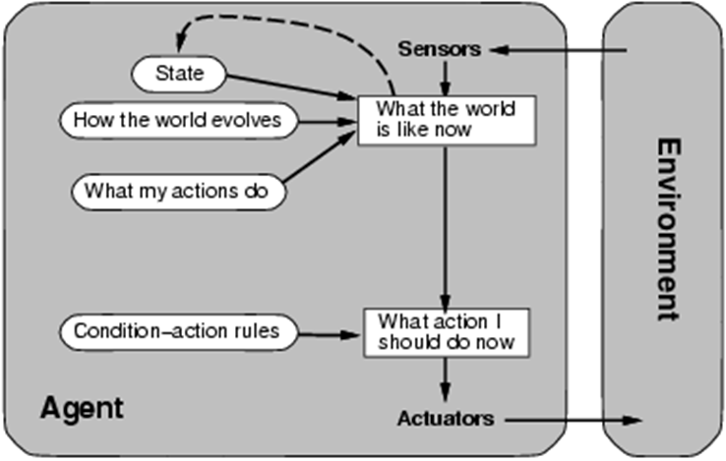
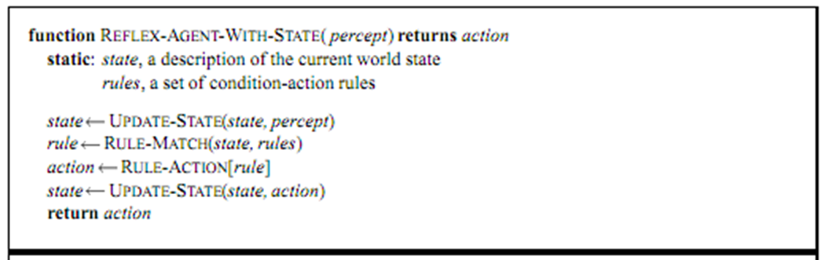
Model-based reflex agents
Know how world evolves
Overtaking car gets closer from behind
How agents actions affect the world
Wheel turned clockwise takes you right
Model based agents update their state
Reference: Artificial Intelligence: A modern approach

Slide 41
Goal-based agents
Knowing state and environment? Enough?
Taxi can go left, right, straight
Have a goal
A destination to get to
Uses knowledge about a goal to guide its actions
E.g., Search, planning
Reference: Artificial Intelligence: A modern approach

Slide 42
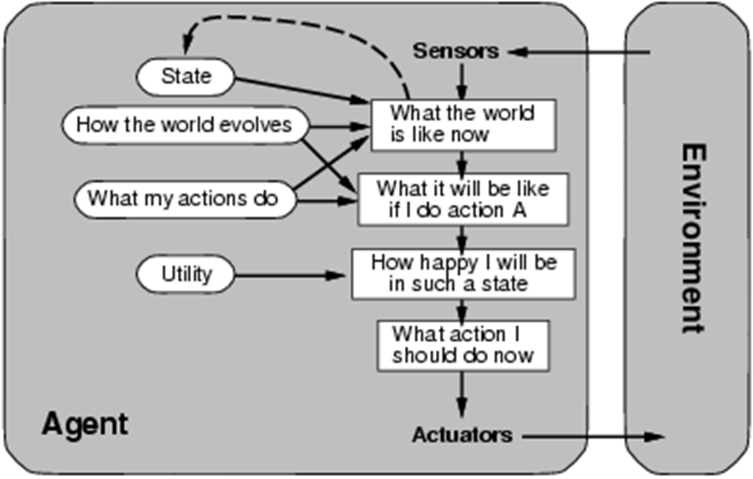
Utility-based agents
Reference: Artificial Intelligence: A modern approach

Slide 43
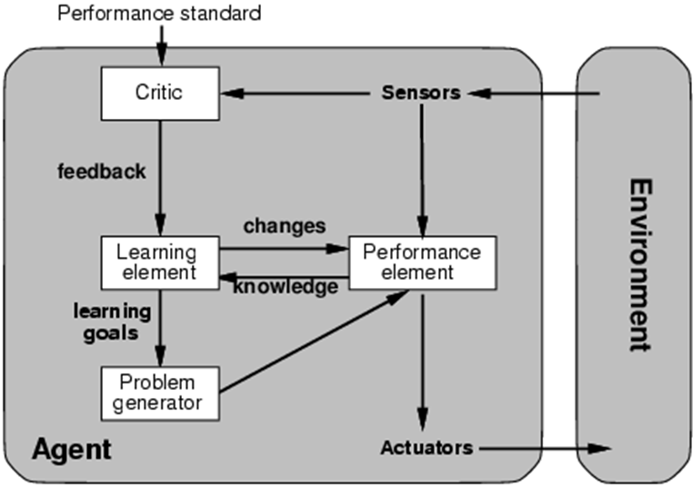
Learning agents
Performance element is what was previously the whole agent
Input sensor
Output action
Learning element
Modifies performance element.
Reference: Artificial Intelligence: A modern approach

Slide 44
Learning agents (Taxi driver)
Performance element
How it currently drives
Taxi driver makes quick left turn across 3 lanes
Critics observe shocking language by passenger and other drivers and informs bad action
Learning element tries to modify performance elements for future
Problem generator suggests experiment: try out something called Brakes on different Road conditions
Exploration vs. Exploitation
Learning experience can be costly in the short run
shocking language from other drivers
Less tip
Fewer passengers
Reference: Artificial Intelligence: A modern approach

Slide 45
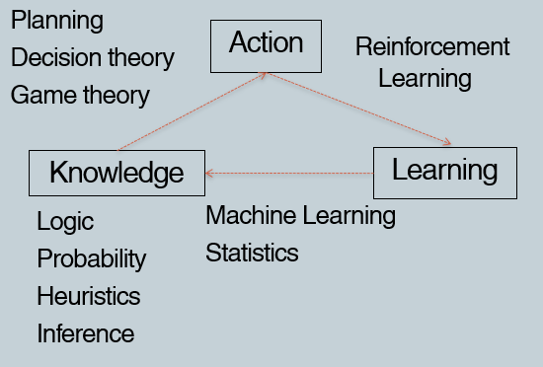
The Big Picture: AI for Model-Based Agents
Reference: Artificial Intelligence: A modern approach

Slide 46
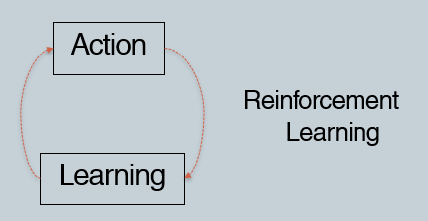
The Picture for Reflex-Based Agents
Studied in AI, Cybernetics, Control Theory, Biology, Psychology.
Reference: Artificial Intelligence: A modern approach

Slide 47
Summary
Agents can be described by their PEAS.
Environments can be described by several key properties: 64 Environment Types.
A rational agent maximizes the performance measure for their PEAS.
The performance measure depends on the agent function.
The agent program implements the agent function.
3 main architectures for agent programs.
Common and useful combinations of environment/agent architecture.
Reference: Artificial Intelligence: A modern approach

Slide 50
PARTNERS

Slide 51
GOLD SPONSOR
Apper
Cloud Labs

Slide 52
GOLD SPONSOR
Tars AI

Slide 53
SILVER SPONSOR

Slide 54


Slide 55
Question and Answer

